Slide 1
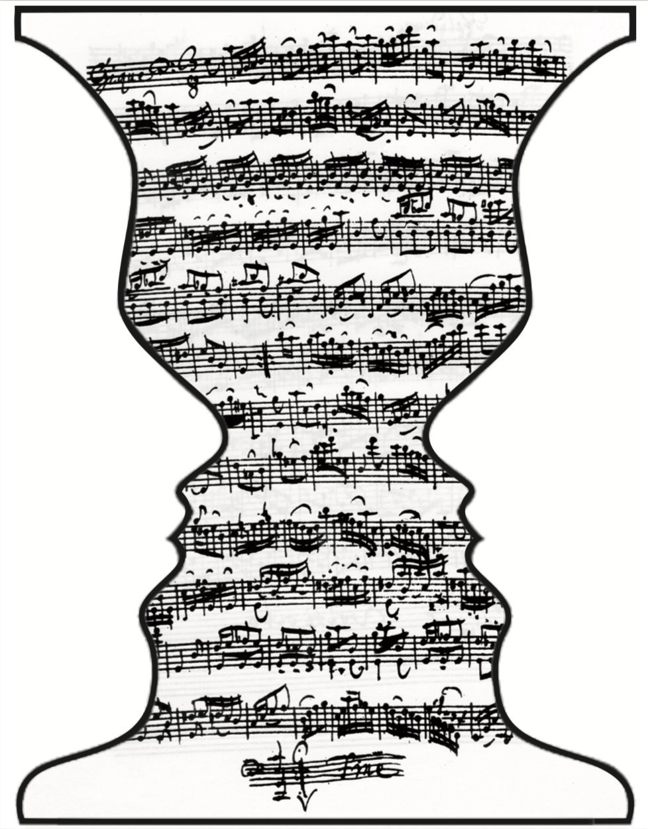



Perception, memory, inferences
Daniel Pressnitzer
daniel.pressnitzer@ens.fr
Laboratoire des Systèmes Perceptifs, CNRS &
Département d’études cognitives, École normale supérieure

Slide 2
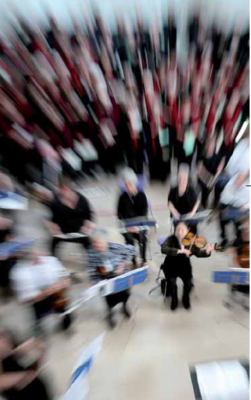
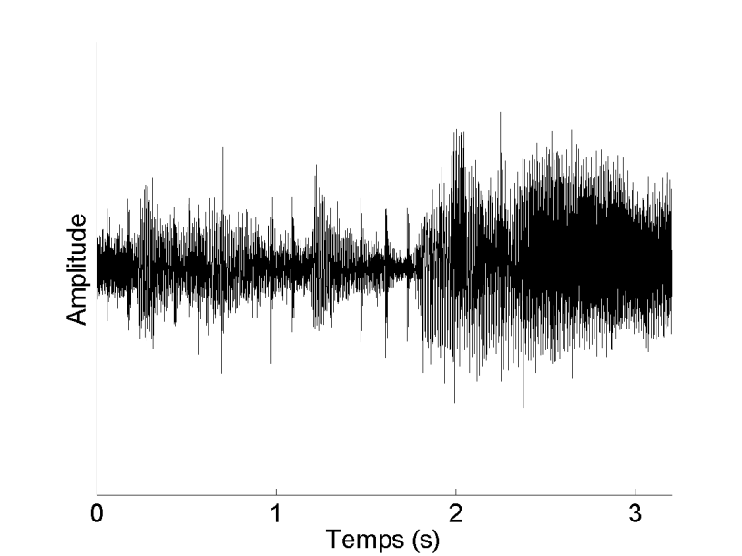
Introduction
Source 1
Source 2
Source N
An ill-posed problem, impossible to solve as is
But we solve it everyday, apparently effortlessly

Slide 3
Introduction
Helmholtz’s unconscious inference
Bayesian priors
Additional knowledge needed to resolve ambiguity
This knowledge is from the past
Predictive coding

Slide 4
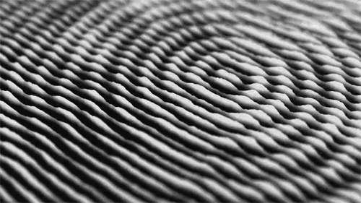
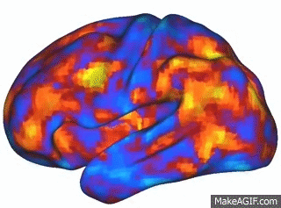
Introduction
Perception
An influential proposal: “unconscious inferences”
-> Psychophysical evidence for unconscious inferences in hearing

Slide 5
Overview
Acquisition of auditory memories
Resolution of perceptual ambiguity
Inter-individual differences

Slide 6
Overview
Acquisition of auditory memories
Resolution of perceptual ambiguity
Inter-individual differences

Slide 7
Memory for noise
Noise to observe new auditory memories in the lab
- never heard before - meaningless - unpredictable
Unsupervised learning task based on repetition

Slide 8





Memory for noise
Trial 7
N
(No)
Trial 6
RefRN
(Yes)
1s noise sample
Repetition detection task
RefRN identical throughout block
-> Improvement for RefRN=memory
Trial 5
N
(No)
Trial 4
RN
(Yes)
Trial 3
RefRN
(Yes)
Trial 2
RN
(Yes)
Trial 1
Frequency
N
(No)
0
0.5
1
Time (s)

Slide 9
Memory for noise
100
Learning
)
2.0
80
′
d
1.5
60
Hit-rate (%)
No learning
1.0
Sensitivity (
40
0.5
20
0.0
RN
RefRN
0
Condition
0
10
20
30
40
50
Trial order within block
Performance advantage for « reference » noises
Learning either absent, or perfect and very fast
Agus, Thorpe, & Pressnitzer, Neuron, 2010

Slide 10
Long-term memories
First visit
Second visit (M = 17 days)
100
100
RefRN
80
80
60
60
Hit-rate (%)
Hit-rate (%)
RN
40
40
20
20
0
0
0
10
20
30
40
50
0
10
20
30
40
50
Trial order within block
Trial order within block
Memories for noises retained over weeks
Agus, Thorpe, & Pressnitzer, Neuron, 2010

Slide 11
Memory for tone clouds
Parametric variation of spectro-temporal complexity
Agus & Pressnitzer, J. Acoust. Soc. Am., 2021

Slide 12
Memory for tone clouds
5.0
RT
RefRT
Tone clouds
4.0
)
Tone-cloud shaped noise
d'
3.0
Sensitivity (
2.0
1.0
0.0
2
8
32
128
512
8192
131072
Noise
Tone-cloud density (tones/oct/s)
Memory for dense and sparse tone clouds
Agus & Pressnitzer, J. Acoust. Soc. Am., 2021

Slide 13
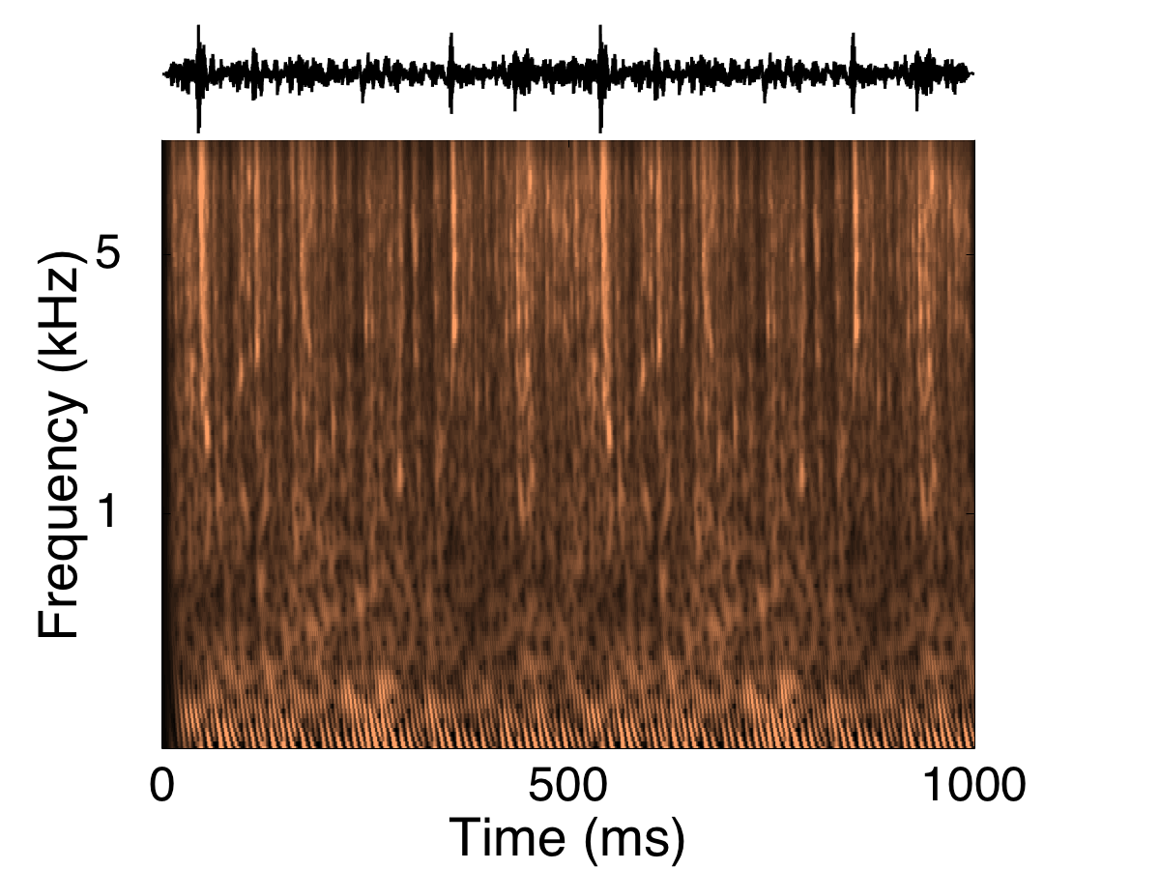
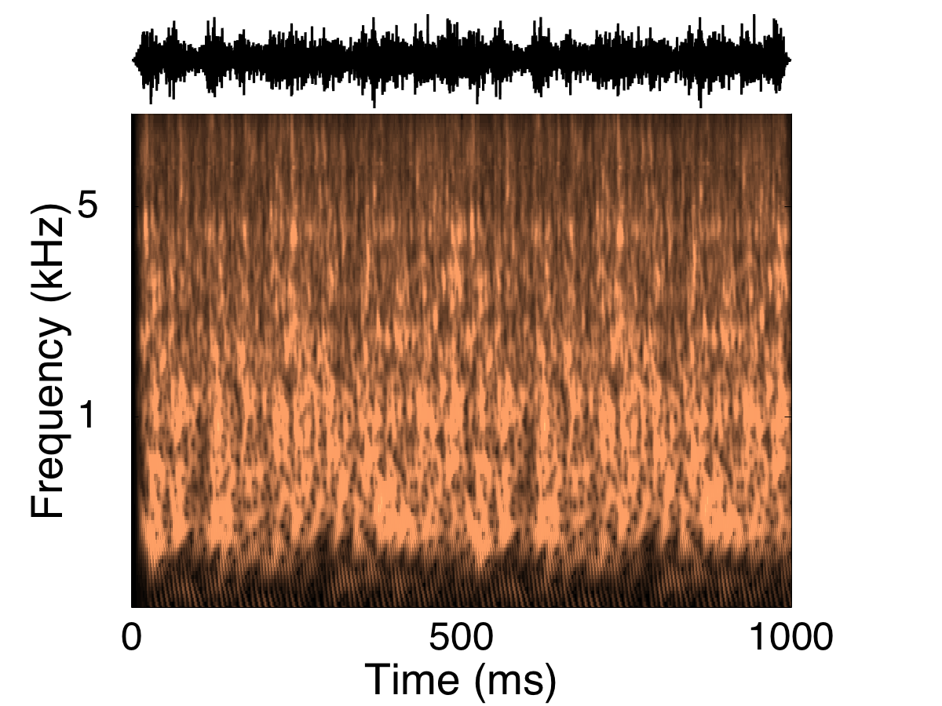
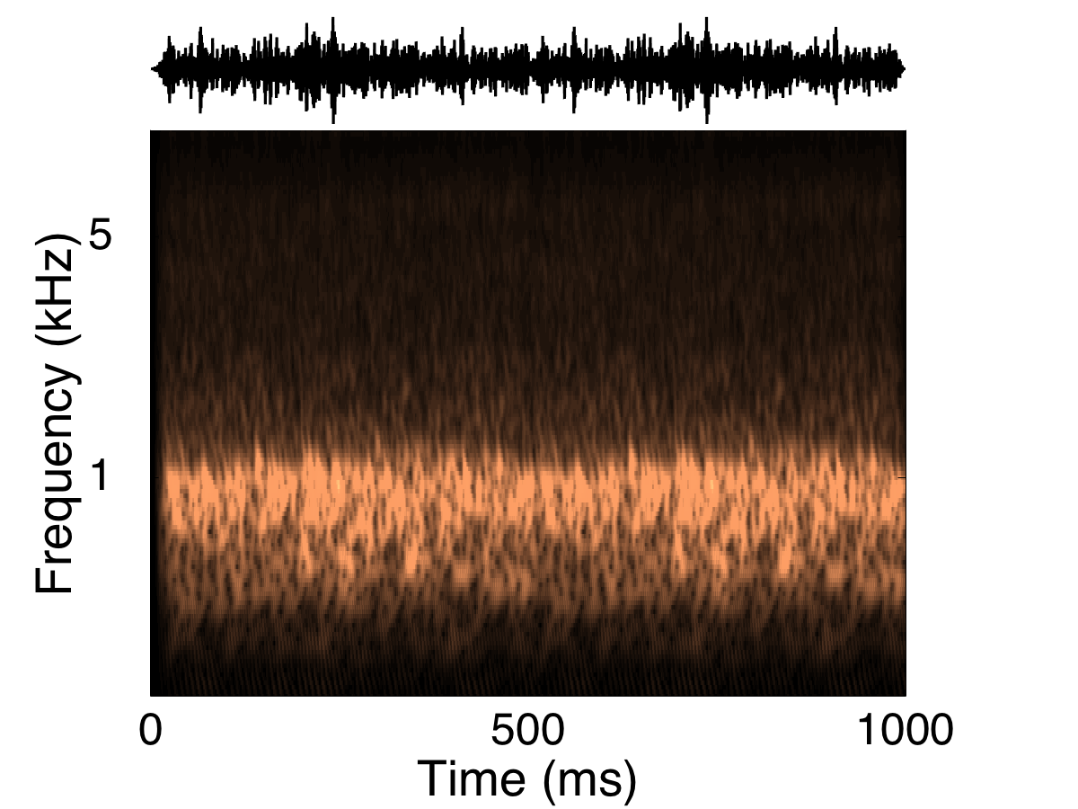
Memory for textures
Fire
Stream
Wind
Statistics from natural sounds
With B. Bastug, V. Rajendran, R. Bianco, & M. Chait

Slide 14
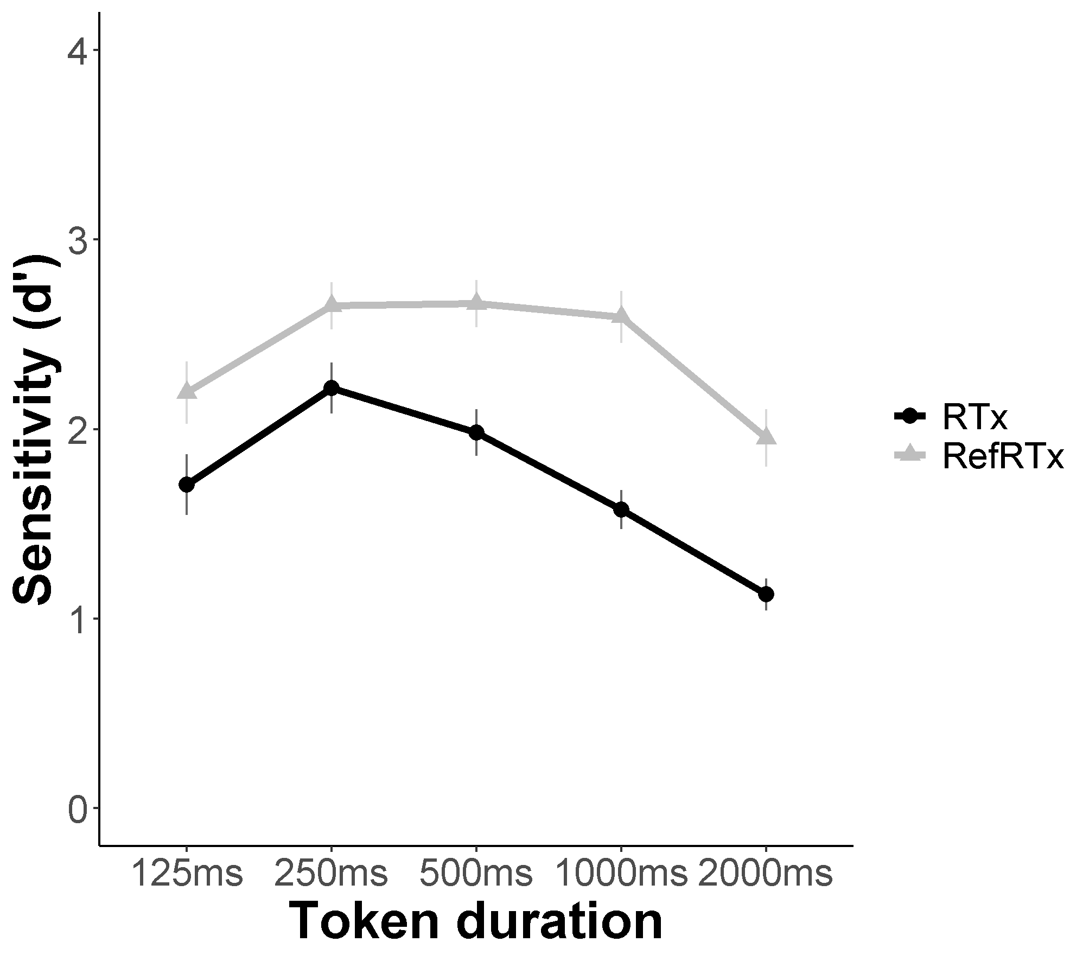
Memory for textures
Memory for short and long duration textures
With B. Bastug, V. Rajendran, R. Bianco, & M. Chait

Slide 15
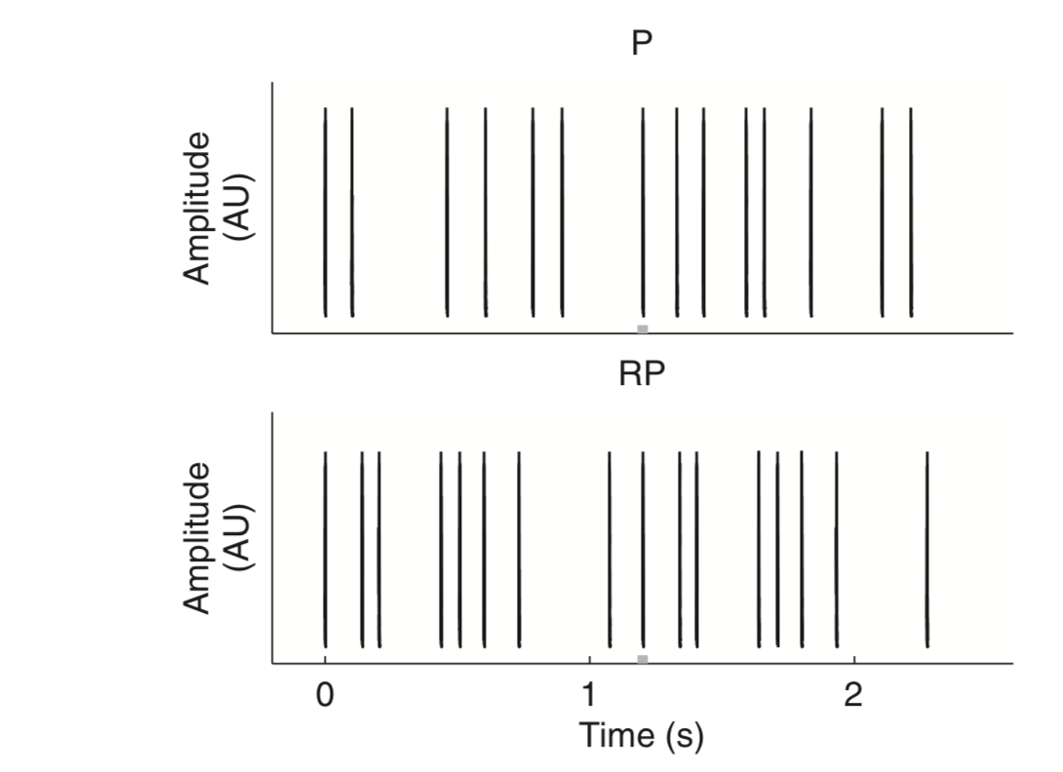
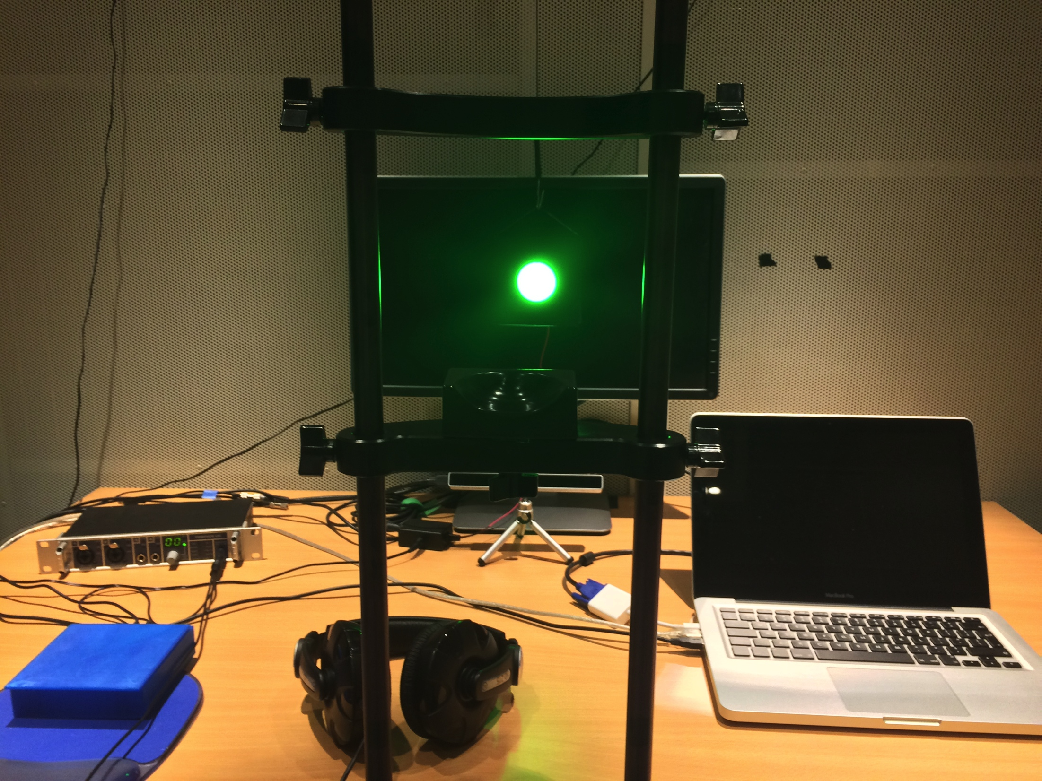
Memory for time patterns
Electric stimulation through a cochlear implant
Stochastic time patterns
Audio clicks, light flashes, touch pulses

Slide 16
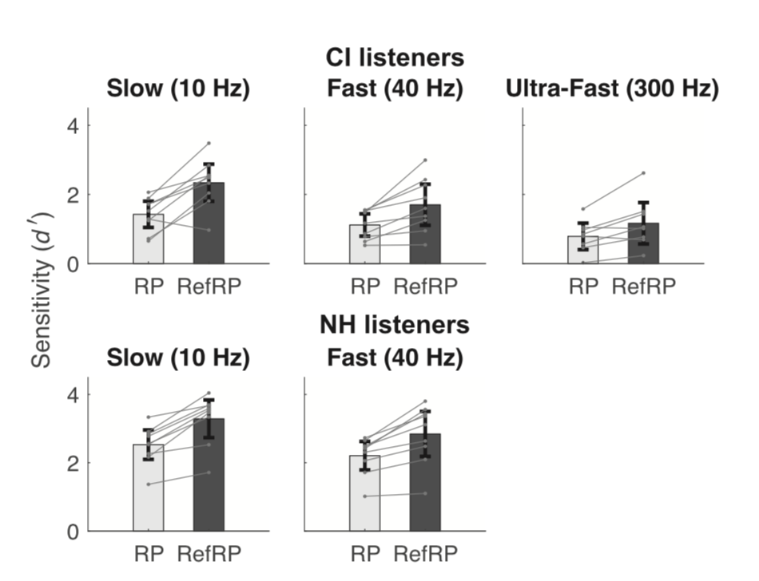
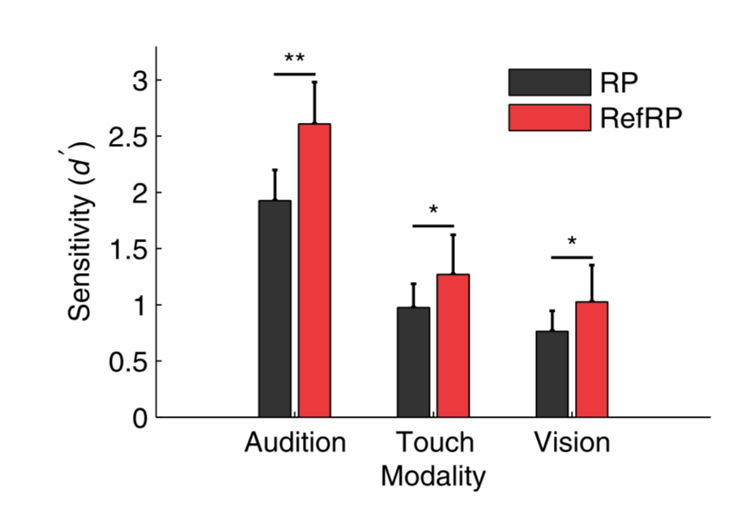
Memory for time patterns
Memory for time patterns in acoustic and electric hearing
Also for vision and touch
Kang, Macherey, Roman, & Pressnitzer, J. Acoust. Soc. Am., 2021
Kang, Lancelin, & Pressnitzer, Neuroscience, 2018
Kang, Agus & Pressnitzer, J. Acoust. Soc. Am.,2017

Slide 17
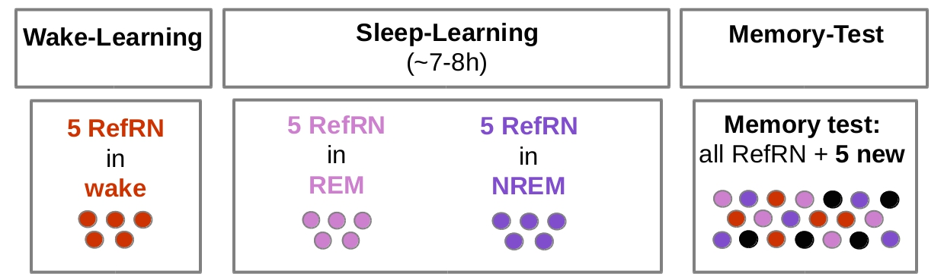
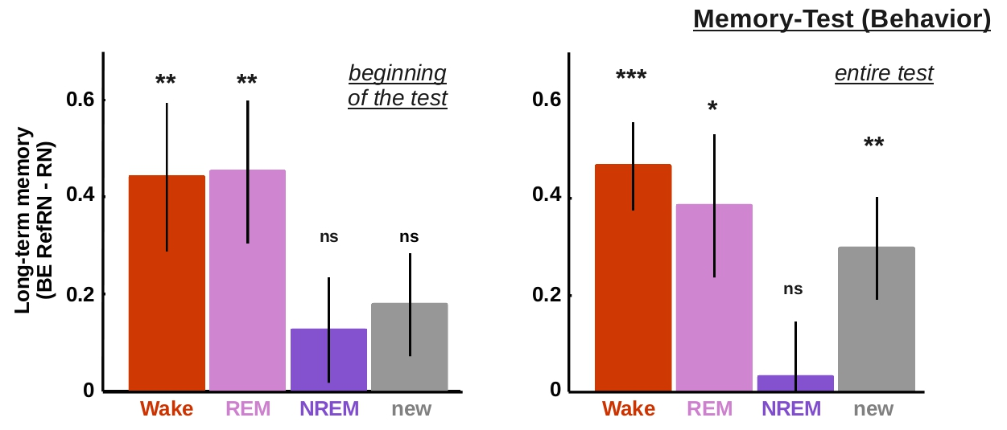
Memory during sleep
REM induces learning, NREM induces suppression
Andrillon, Pressnitzer, Léger, & Kouider, Nature Communications, 2017

Slide 18
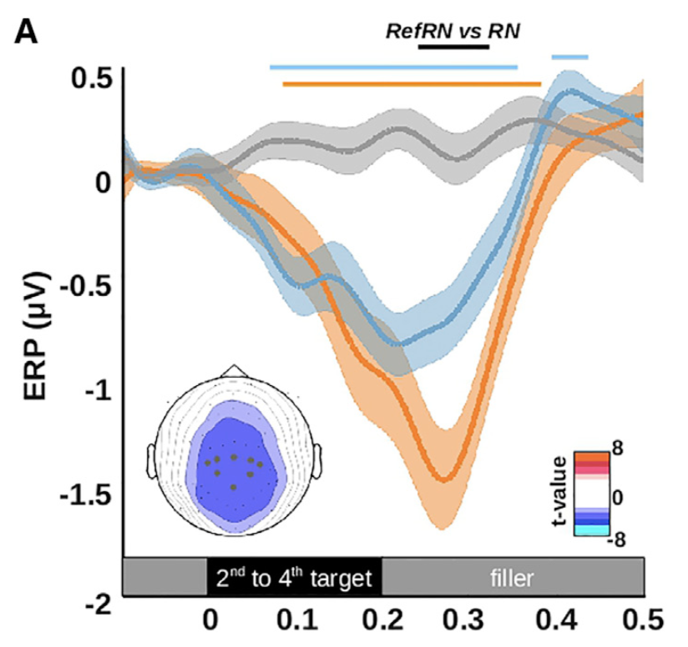
Neural correlates
Neural correlates suggest rapid plasticity in sensory regions (see also Luo et al., Curr Biol, 2013; Bianco et al., eLife, 2020, Hermann et al., NeuroImage, 2021)
Andrillon, Agus, Kouider & Pressnitzer, Current Biology, 2015
Kumar, Bonnici, Teki, Agus, Pressnitzer, Maguire, & Griffiths, Phil Trans Royal Soc B, 2014

Slide 19
Memory for noise
Rapid formation of “latent” memories after repetition
Unsupervised/incidental, without focused attention
Neural correlates from sensory cortex
-> Auditory experience constantly shapes auditory processing

Slide 20
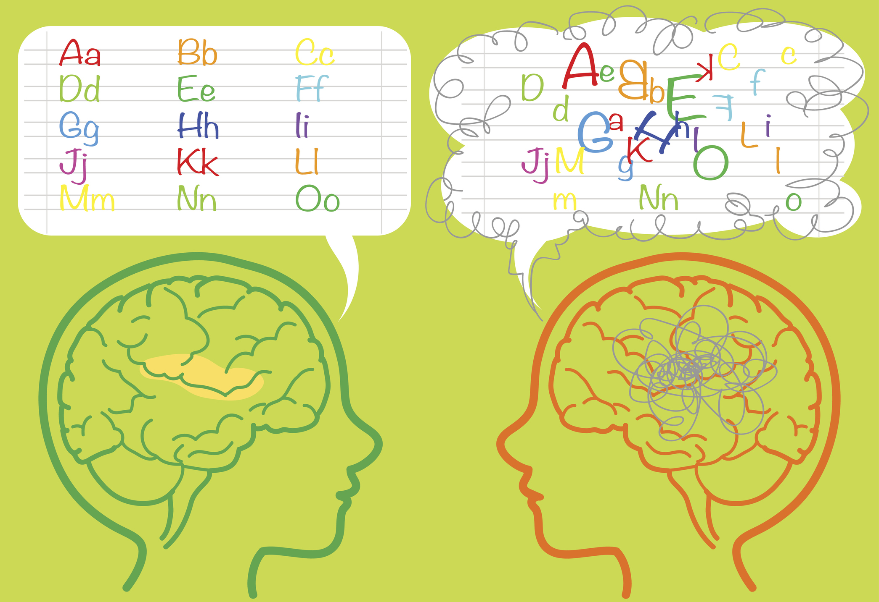
Clinical populations
Dyslexia
Linked to deficit in phonological representation, or access
Sensory memory ?
No difference with matched controls (but see Daikhin et al., 2017)
Agus, Carrión-Castillon, Pressnitzer, & Ramus, JSLHR, 2014

Slide 21
Tinnitus proposal
Prevent T reinforcement
T suppresses itself
Tinnitus as maladaptive plasticity (e.g. Norena, Audiol Neurotol, 2015)
Leverage plasticity during sleep (e.g. Theodoroff et al, AJA, 2017)
Fine tune stimulation to sleep phase ?

Slide 22
Musical interlude
The original use of noise to probe auditory memory was from a pioneer of computer music!

Slide 23

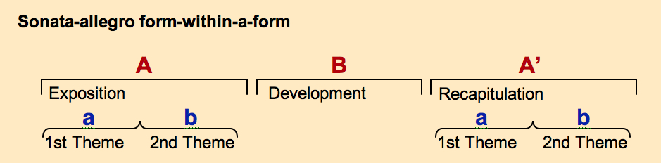
Musical interlude
Christian Fennesz, “Happy Audio”
Memory is at the core of many classical forms
In some cases, memory seems the main structural factor

Slide 24

Illusion interlude
The speech to song illusion : repetition changes perception
http://deutsch.ucsd.edu/psychology/pages.php?i=212
Deutsch, Henthorn, & Lapidis. Journal of the Acoustical Society of America, 2011

Slide 25
Overview
Acquisition of auditory memories
Resolution of perceptual ambiguity
Inter-individual differences

Slide 26
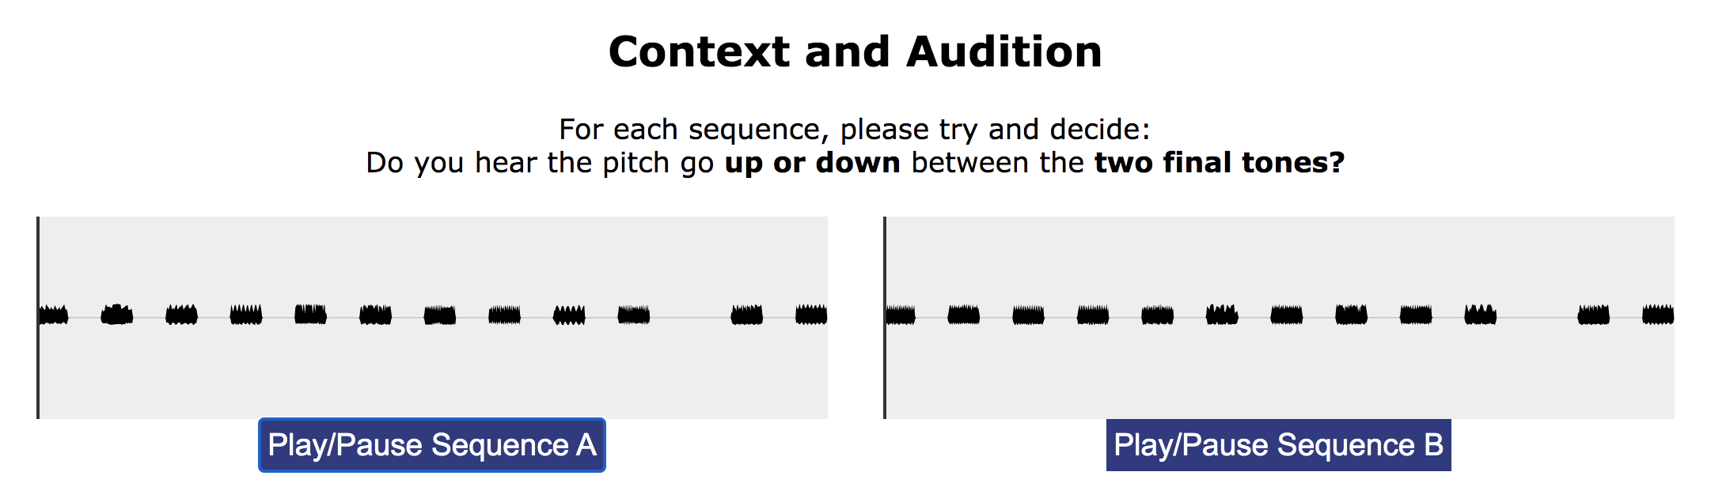
Ambiguity resolution
Frequency (octave)
Ambiguous frequency shifts
What you heard before changes what you hear now
Time
Chambers, Akram, Adam, Pelofi, Sahani, Shamma, & Pressnitzer, Nature Communications, 2017
http://audition.ens.fr/dp/illusion/

Slide 27
Ambiguity resolution
1 oct.
What you have just heard: Shepard tones
Shepard, R. J. Acoust. Soc. Am., 1964

Slide 28
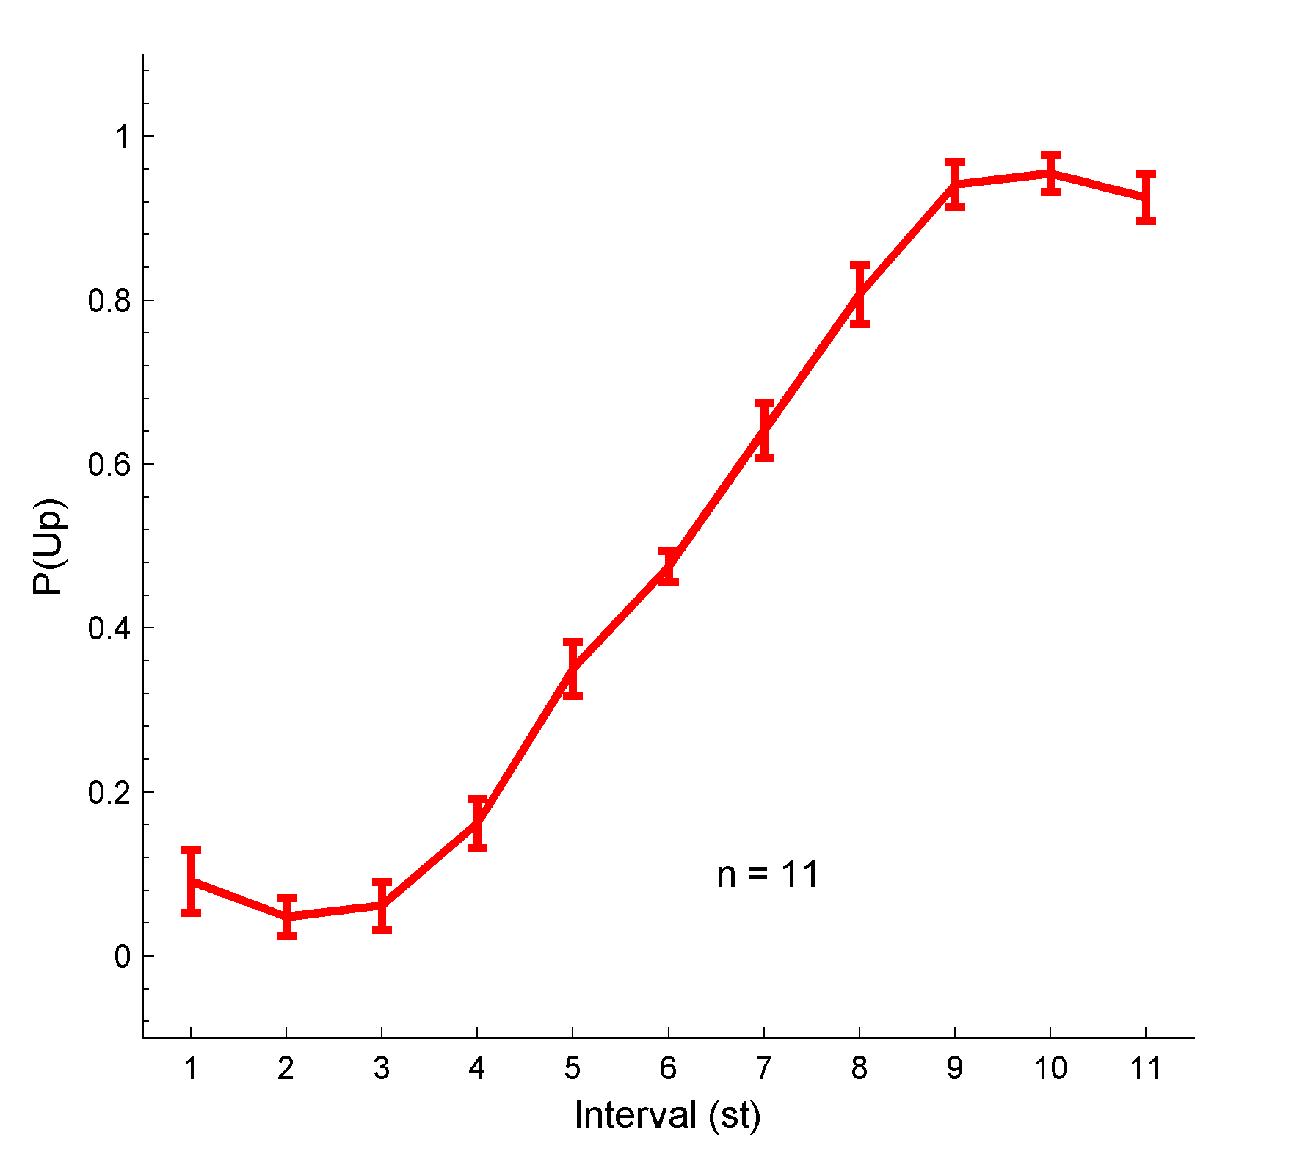
Ambiguity resolution
Perceived pitch shift
1 oct.
Ambiguous pitch shift at 6 semi-tones interval

Slide 29
Ambiguity resolution
Biasing sequence
Perception can be almost fully determined by context

Slide 30
Ambiguity resolution
How long does it take?
Bias observed for a 20-ms long context

Slide 31
Ambiguity resolution
How much does it last?
Bias persists for over 30s

Slide 32
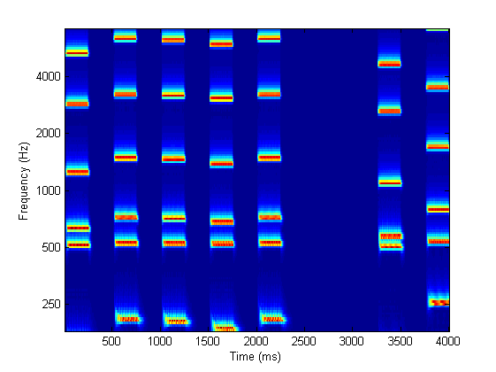
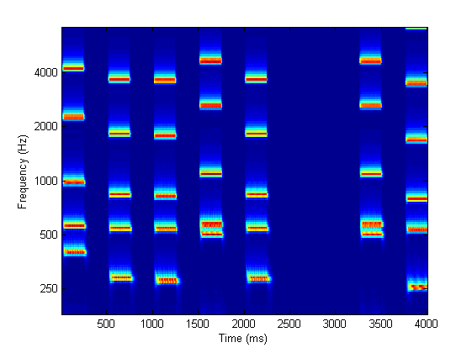
Ambiguity resolution
Something to do with Shepard tones?
Notes:
32
acknowledgements

Slide 33
Ambiguity resolution
Something to do with Shepard tones?
Generalisation to random spectra, limited by resolvability

Slide 34
Ambiguity resolution
MEG response suppression correlates with behavior
Notes:
34
acknowledgements

Slide 35
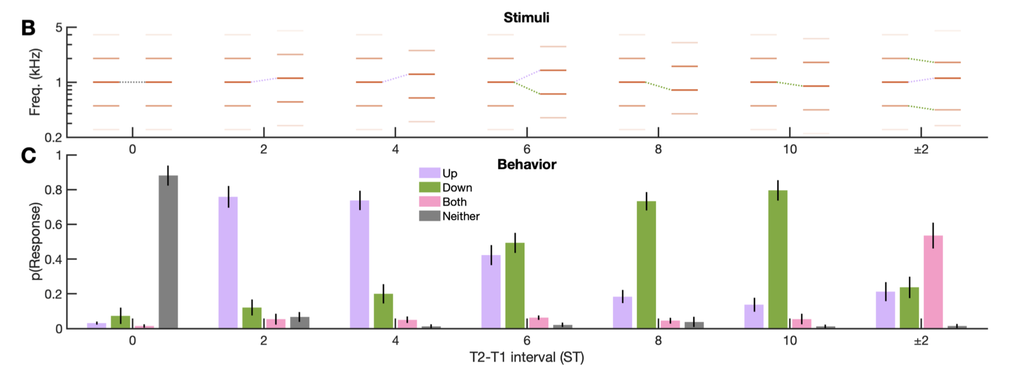
Ambiguity resolution
Awareness of stimulus ambiguity?
Varying degrees of explicit and implicit ambiguity, including ambiguity “deafness”
Pelofi, de Gardelle, Egré, & Pressnitzer, Philos Trans R Soc B, 2017
Graves, Egré, Pressnitzer, & de Gardelle, PNAS, In press

Slide 36
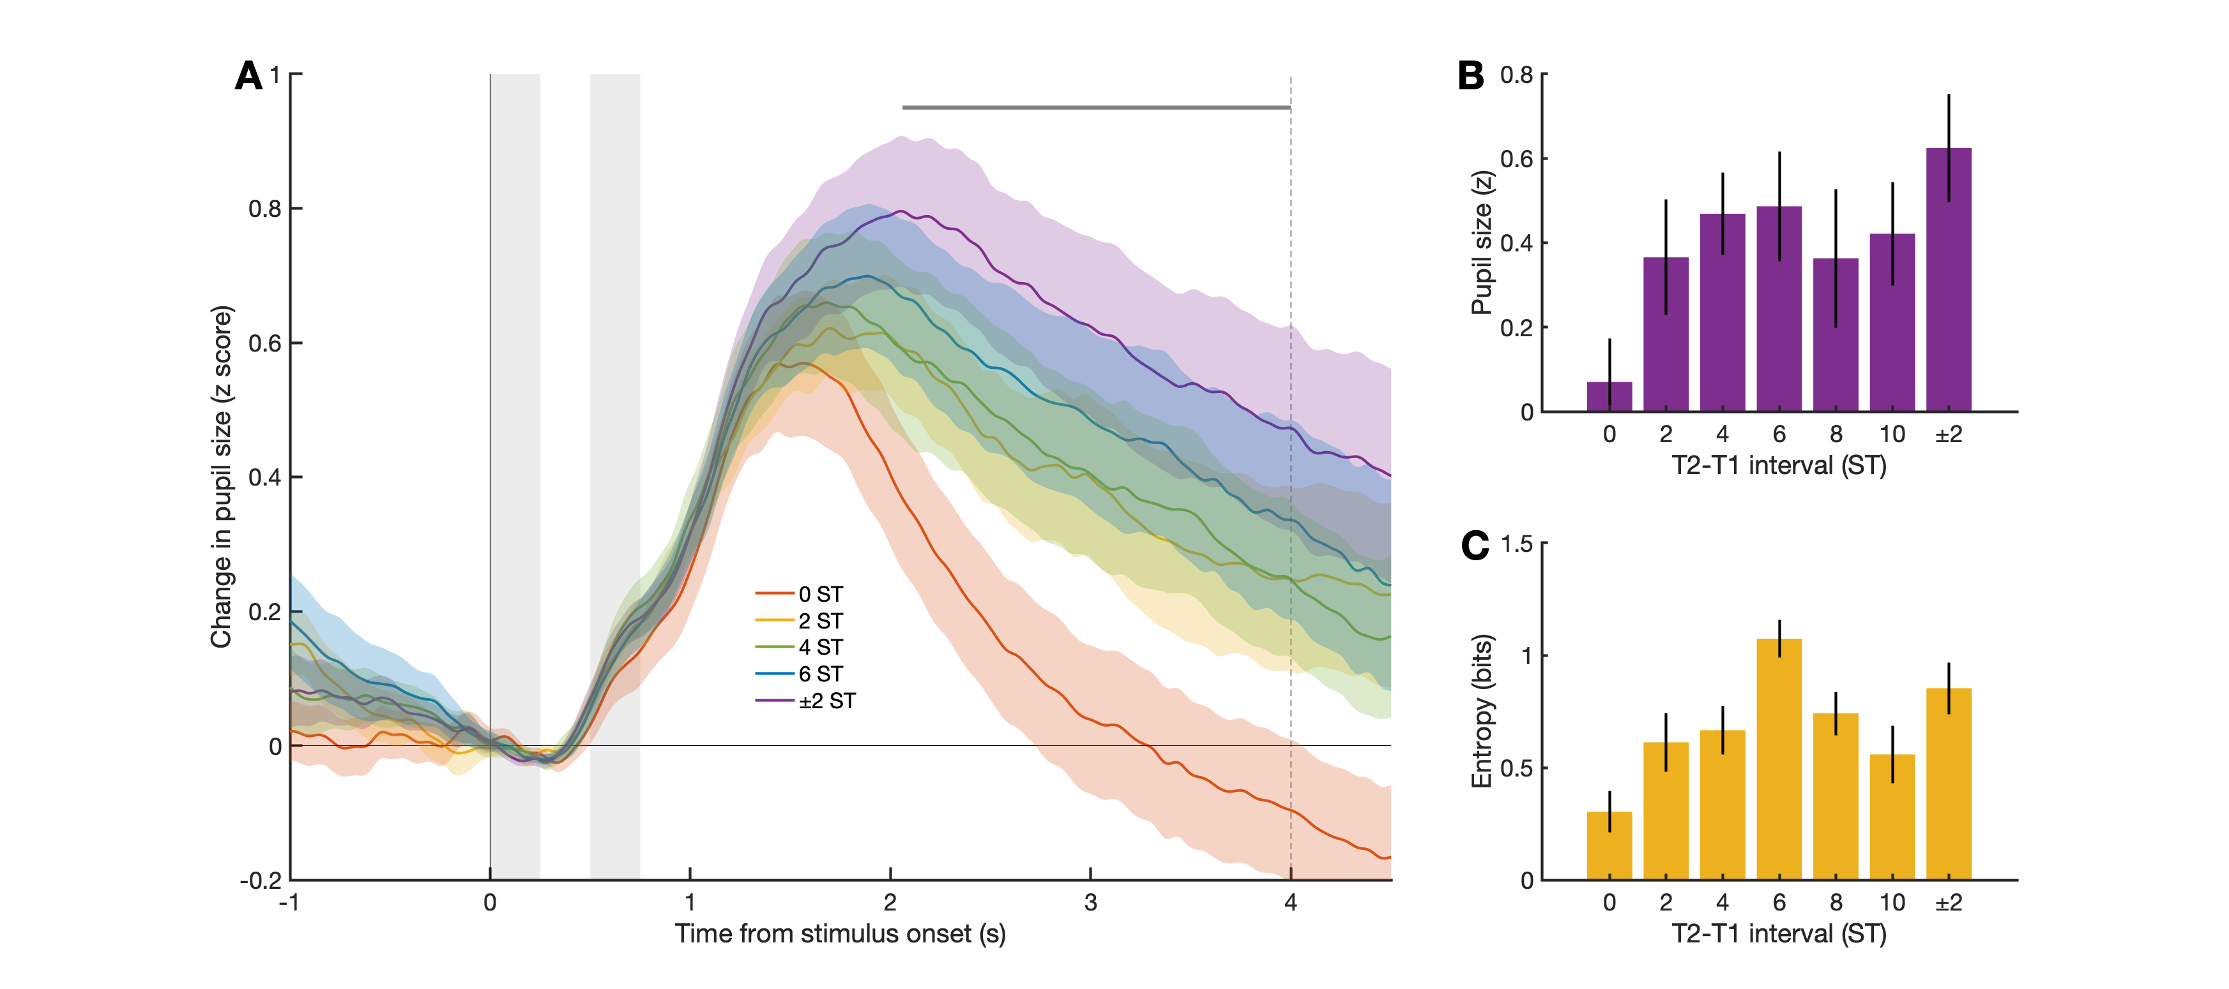
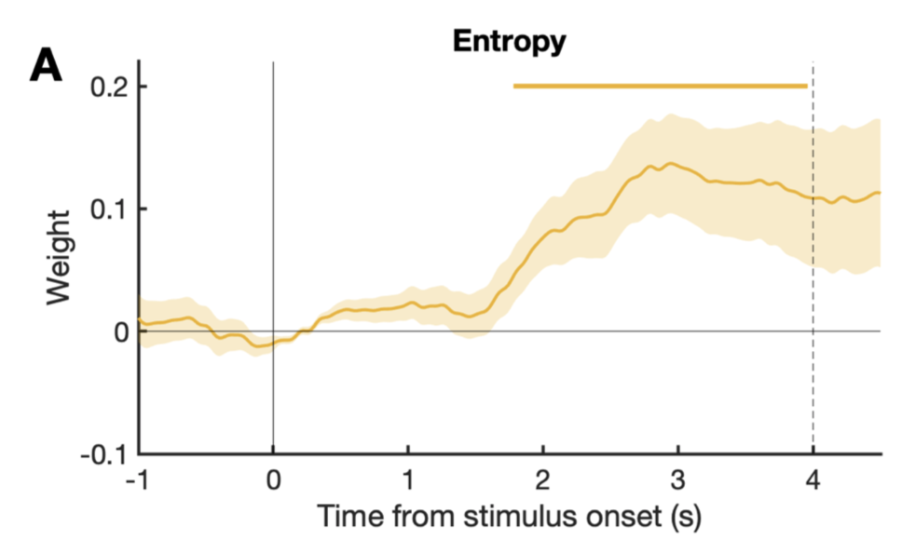
Ambiguity resolution
Recording of pupil size during the task
Pupil size predicted by future entropy of behavioral responses
Irrespective of awareness of ambiguity
Neuromodulation involved in ambiguity resolution?
Graves, Egré, Pressnitzer, & de Gardelle, PNAS, in press

Slide 37
Ambiguity resolution
Current and prior evidence combined to resolve ambiguity
With or without conscious access to ambiguity
-> A framework for perceptual inference in the general case

Slide 38
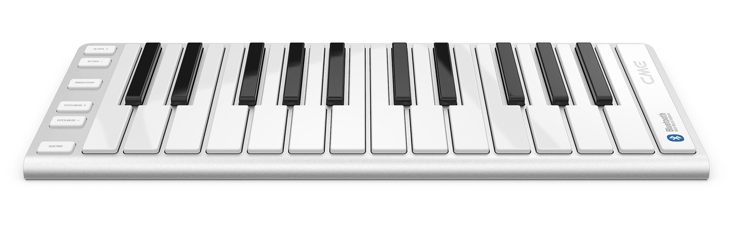
Illusion interlude
A musical scale
Anything funny?
Demo after Shepard, 1964 & Risset, 1971

Slide 39

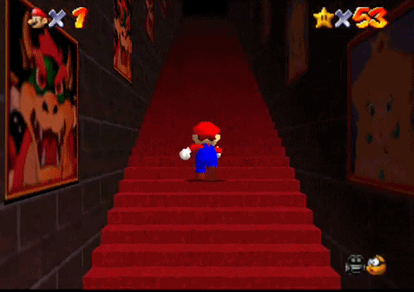
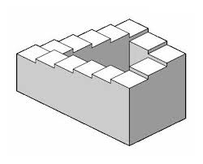
Musical interlude
Proximity cues and cyclic Shepard tones for “infinite” scale

Slide 40
Overview
Acquisition of auditory memories
Resolution of perceptual ambiguity
Inter-individual differences

Slide 41
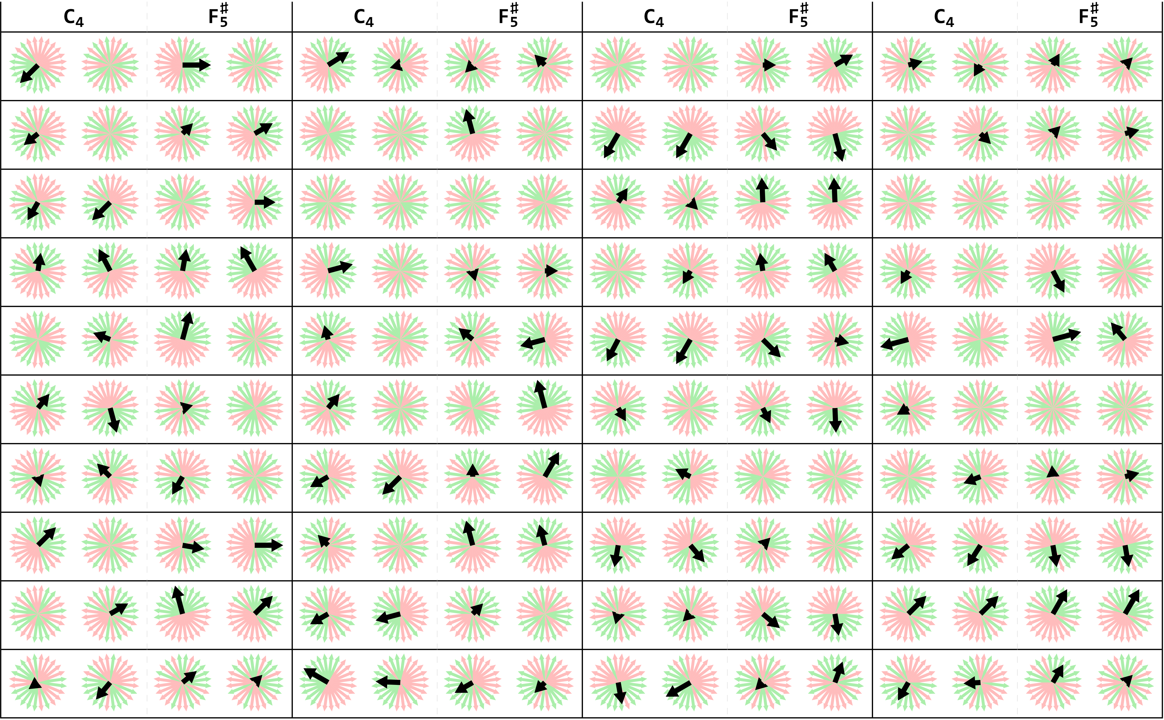
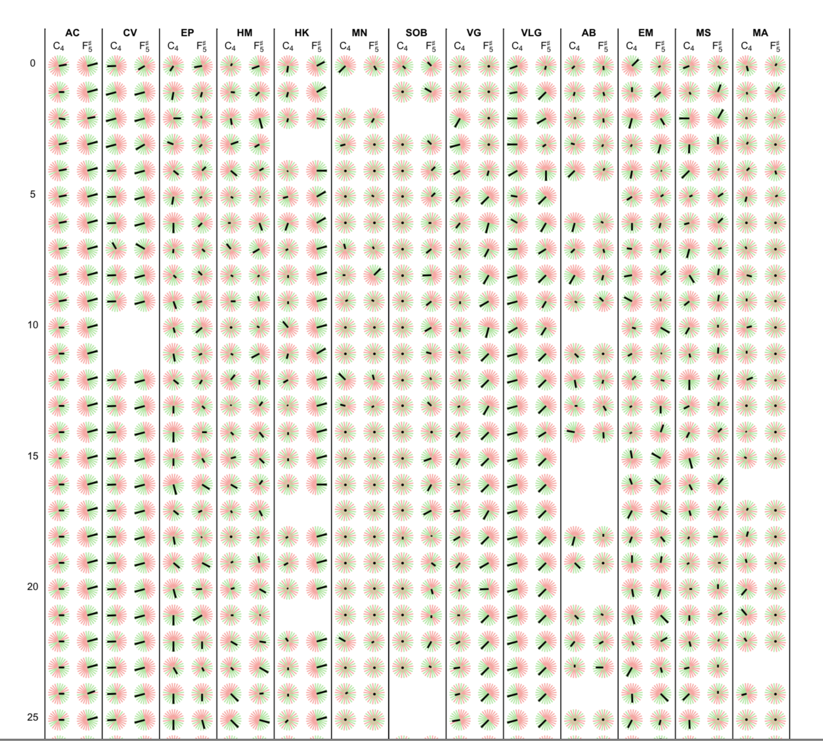
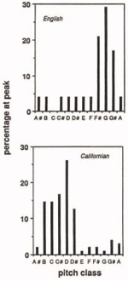
Biases for frequency shifts
Deutsch, Music Perception, 1986; 1997
Auditory experience should impact the inference process
Individual biases for ambiguous frequency shifts
Variability in direction and strength of the bias
With M. Wexler

Slide 42
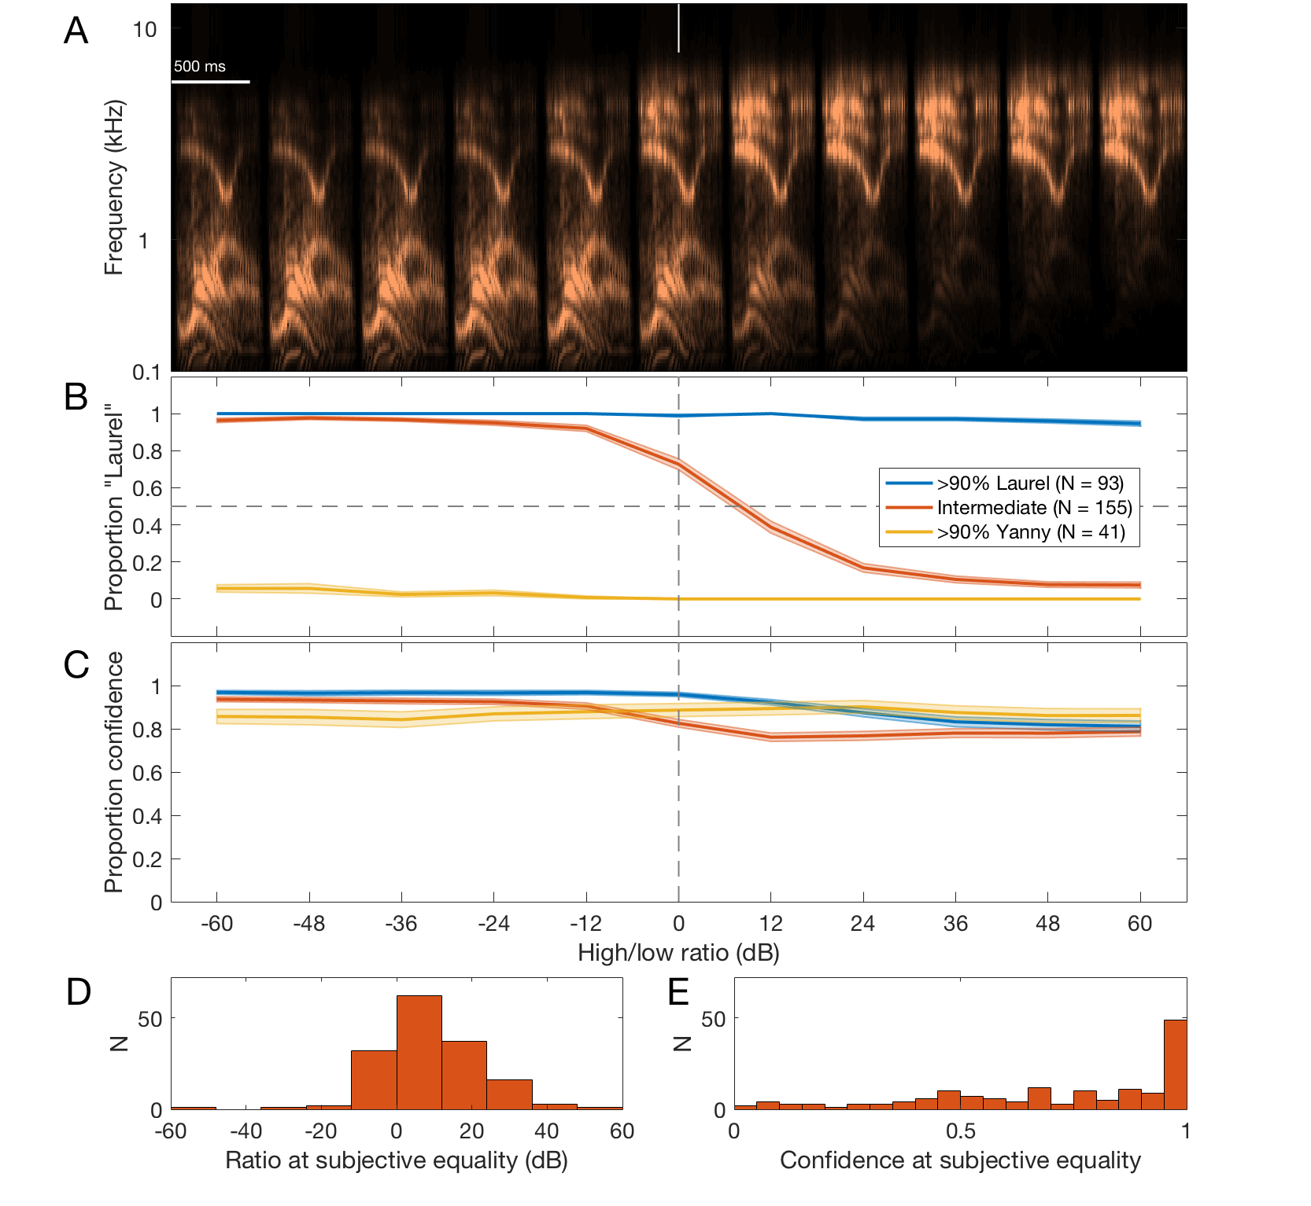
Biases for speech
Do you hear “Laurel” or “Yanny” ?

Slide 43
Biases for speech
Laurel in low frequencies, Yanny in high frequencies
Experiment, “Do you hear Laurel or Yanny?”
“How confident are you?”

Slide 44
Biases for speech
Pressnitzer, Graves, Chambers, de Gardelle, & Egré, Current Biology, 2018

Slide 45
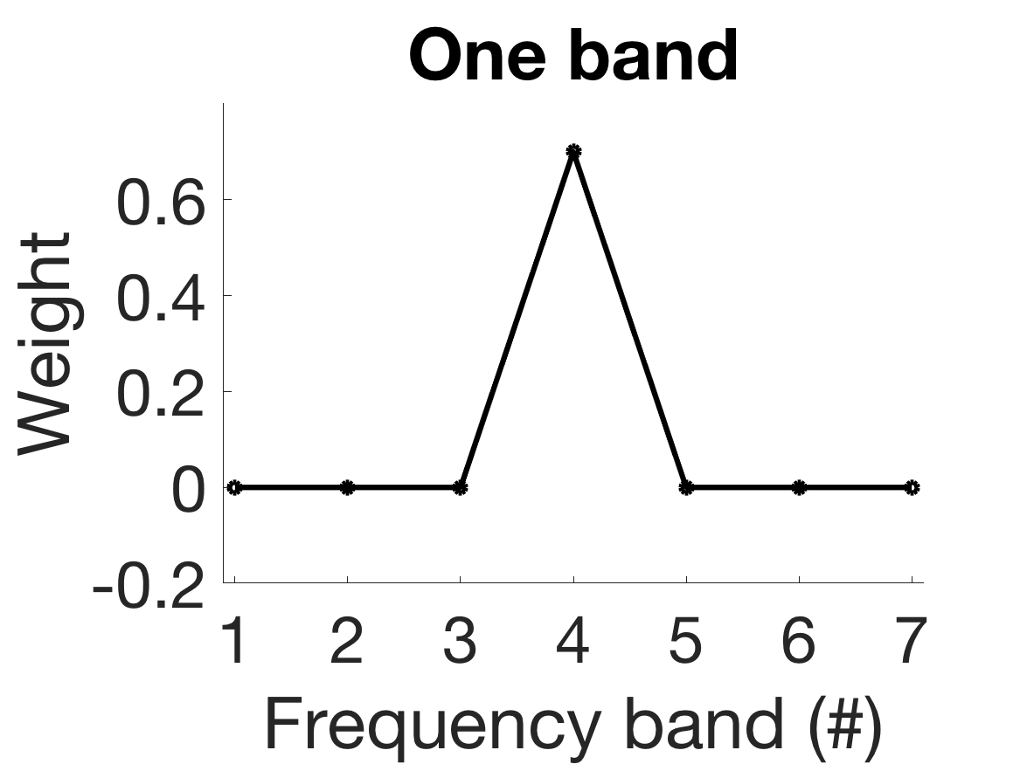
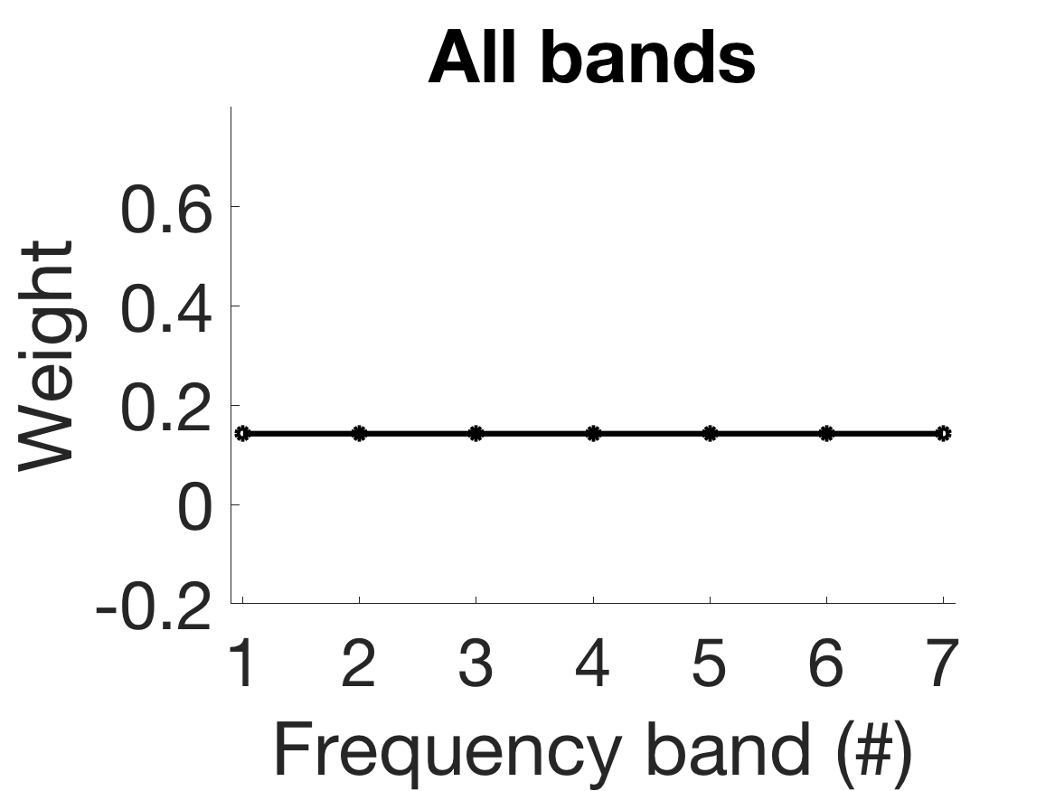
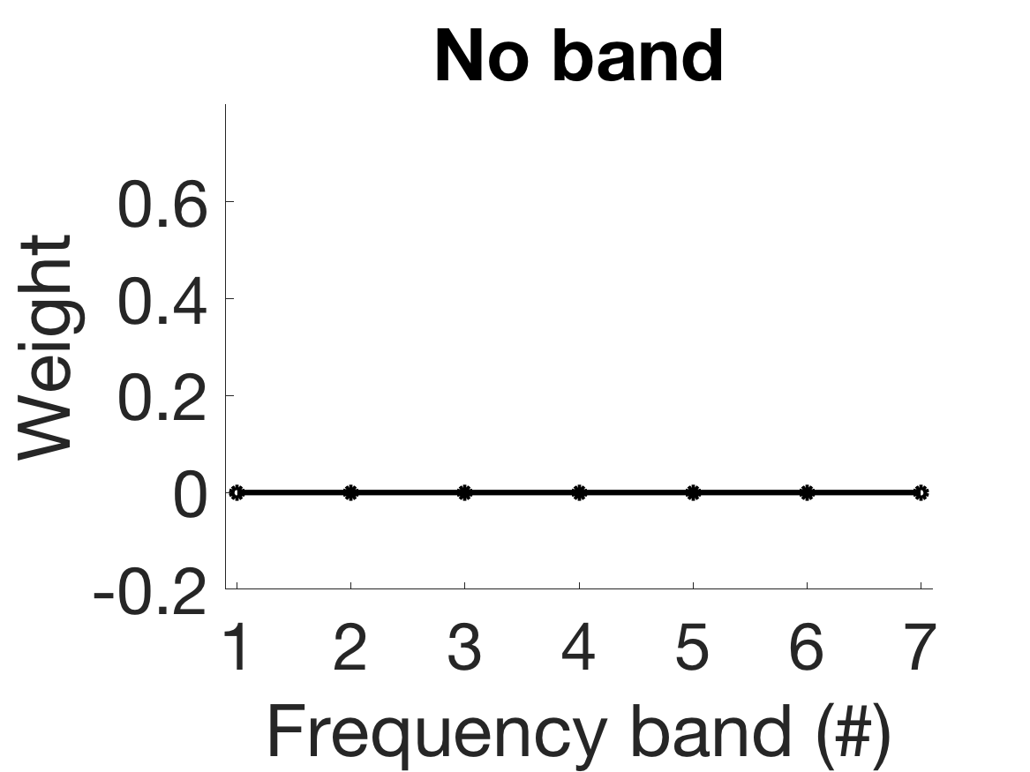
Inter-individual differences
Amplitude
Amplitude
Frequency
Frequency
Pitch judgement, up or down
Implicit “perceptual weights” for different frequency regions?
Reverse correlation to estimate perceptual weights
With L. Demany, R. Bravard

Slide 46
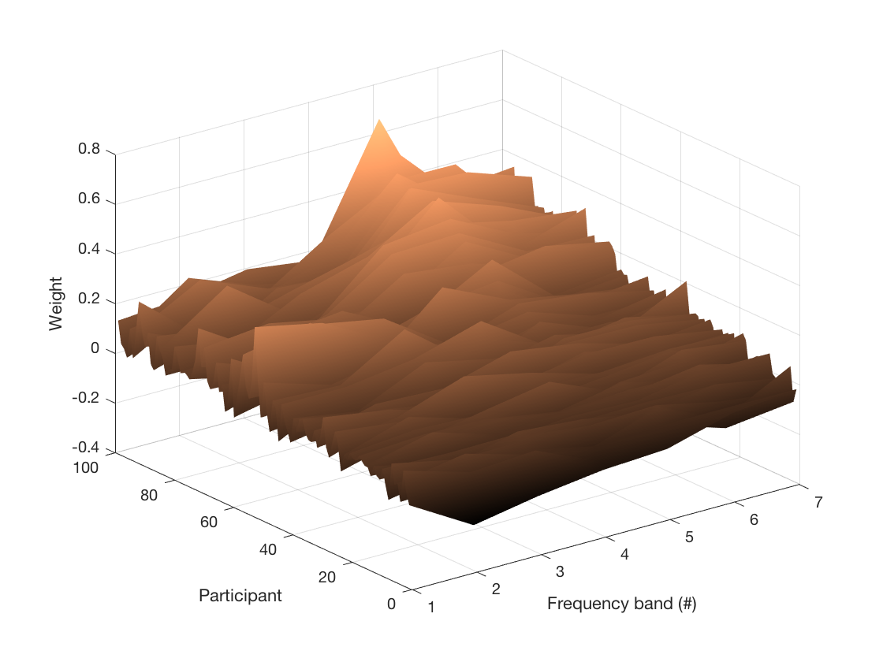
Inter-individual differences
Online experiment for large cohort
A mode and some variability

Slide 47
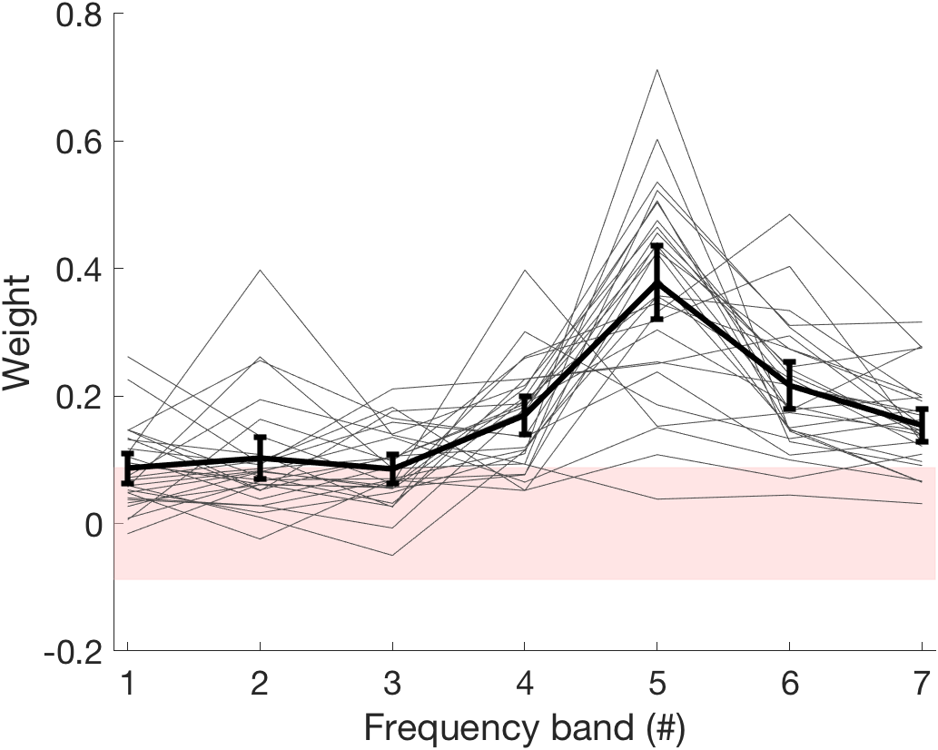
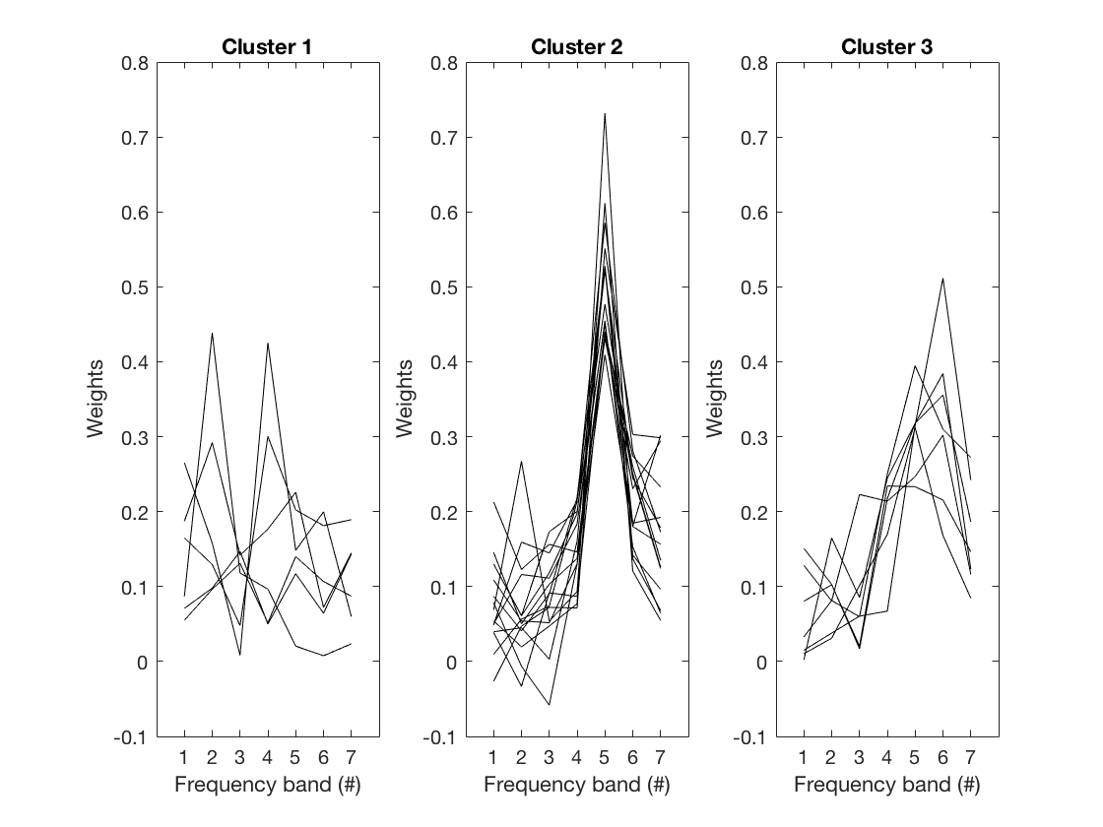
Inter-individual differences
Sub-group of participants for follow-up
A variety of weight shapes
Is it measurement noise?

Slide 48
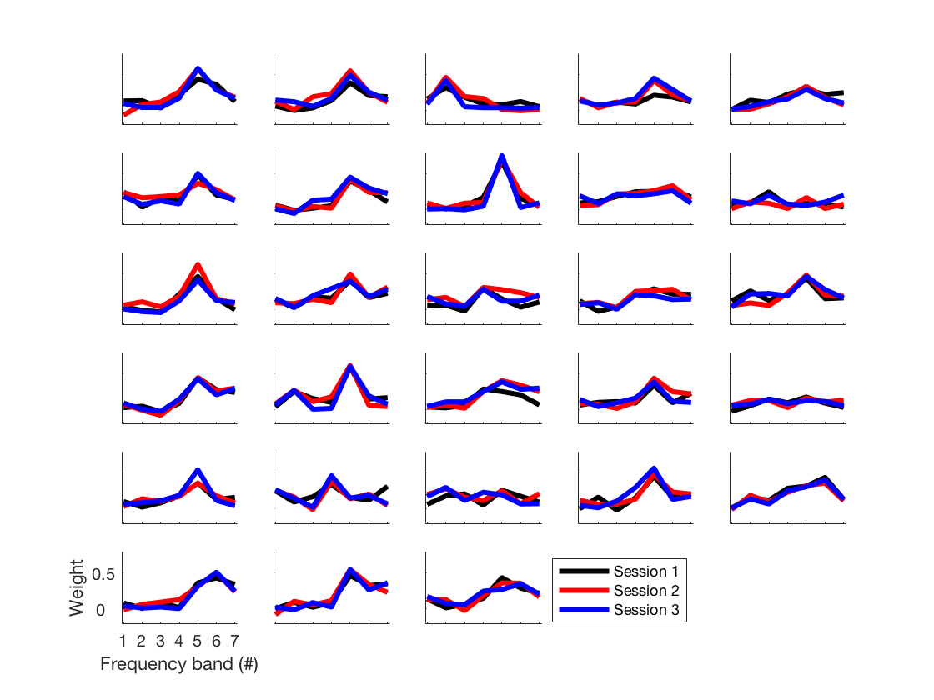
Inter-individual differences
Three sessions: T0; T0 + 1 month; T0 + 1 month + 1 day
No, not noise: striking stability
Wait, is it simply audibility?

Slide 49
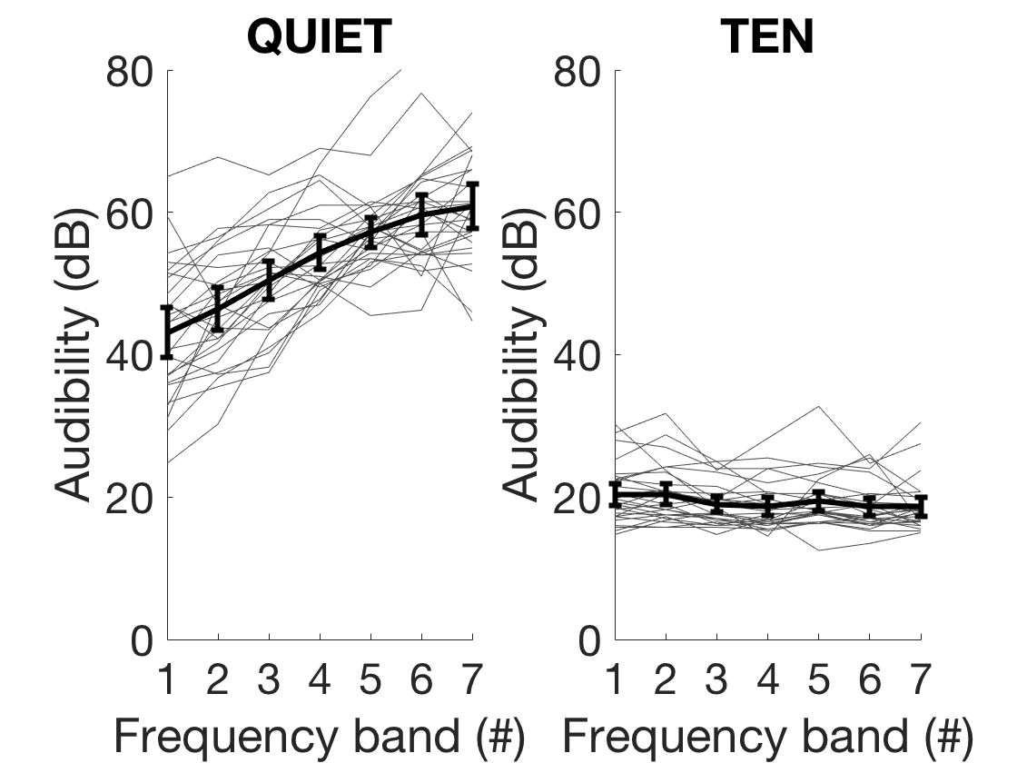
Inter-individual differences
No, not audibility: shape is different
Really not audibility: all sounds in Threshold-Equalizing Noise

Slide 50
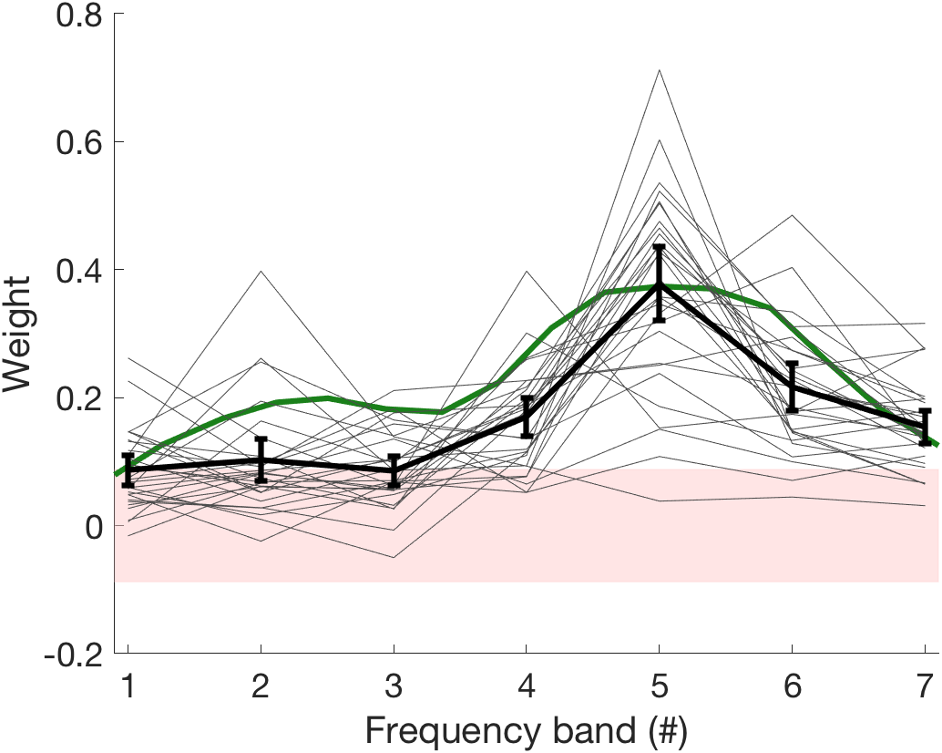
Inter-individual differences
Inter-individual differences in frequency-change perception
What about the average mode?
Matches “frequency importance function” of speech…

Slide 51
Inter-individual differences
Idiosyncratic patterns of implicit frequency-weighting
Adaptive match to relevant acoustic information?
What happens if maladaptive mismatch?
Can we imagine rehabilitation regimens if mismatch?
-> New characterizations of supra-threshold hearing profiles

Slide 52
Conclusion
Perception is intertwined with memory
Resolution of ambiguity highlights “unconscious inference”
A possible basis for supra-threshold interindividual differences

